Slide 1
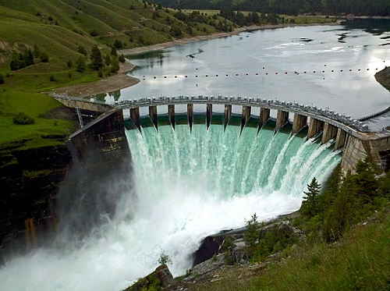




Water Temperature and Water Quality Modeling Capabilities in HEC-ResSim and HEC-RAS
Todd E. Steissberg¹, Mark Jensen², Leila Ostadrahimi², Zhonglong Zhang³, Stephen Andrews⁴, Billy E. Johnson⁵, John F. DeGeorge⁴, and Joan D. Klipsch²
¹Environmental Laboratory, U.S. Army Engineer Research and Development Center (ERDC-EL)
²Hydrologic Engineering Center, U.S. Army Corps of Engineers
³Portland State University
⁴Resource Management Associates (RMA)
⁵LimnoTech, Inc.
September 26, 2022

Slide 2
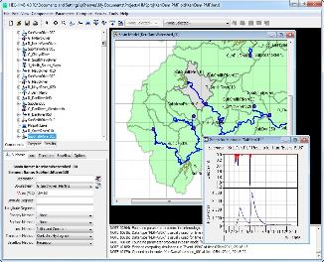
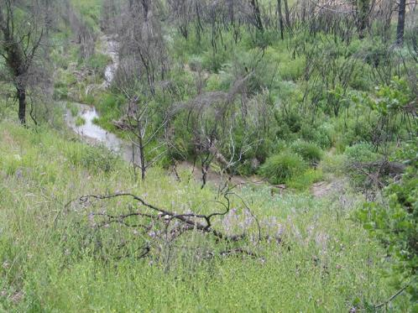
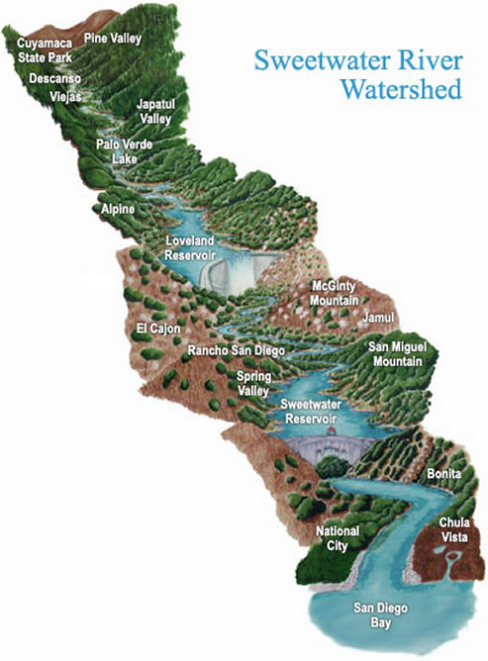
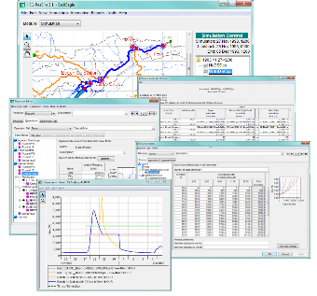
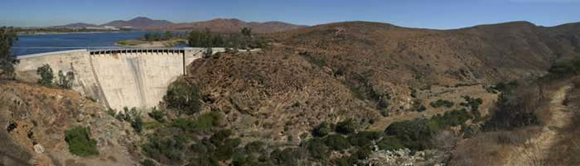
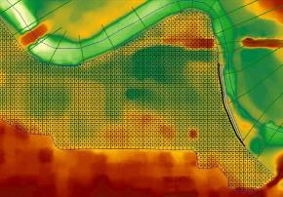
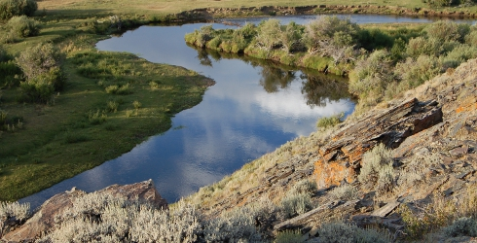
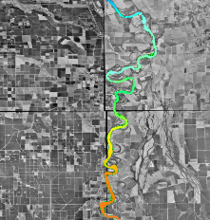
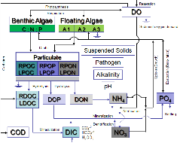
Integrated Watershed Water Quality Modeling
HEC-HMS
Runoff
Linked with
CWMS (real-time)
HEC-WAT (studies)
HEC-ResSim
Reservoir release decisions
Clearwater modules and engine
CE-QUAL-W2
2D Reservoir WQ
HEC-RAS
River hydraulics

Slide 3
Environmental Modeling Capabilities
To develop new water quality capabilities efficiently and effectively, they will be integrated within an existing hydrologic or hydraulic (H&H) model. The U.S. Army Corps of Engineers uses several widely deployed models that simulate watershed runoff, river hydraulics, and reservoir operations. Our team at USACE-ERDC has developed a modular library of environmental modeling capabilities.
ClearWater (Corps Library for Environmental Analysis and Restoration of Watersheds) provides environmental simulation capabilities that are designed to leverage existing hydrologic and hydraulic (H&H) models.
Water quality kinetics and vegetation simulation modules:
NSM: Nutrient Simulation Module (NSM-I and NSM-II)
TSM: Temperature Simulation Module
GSM: General Constituent Simulation Module
CSM: Contaminant Simulation Module
MSM: Mercury Simulation Module
SSM: Solids Simulation Module
RVSM: Riparian Vegetation Simulation Module
A water quality engine that computes the transport (advection and diffusion) of heat and mass across the watershed
Data visualization and reporting capabilities
A water quality framework integrates the water quality modules, water quality engine, existing H&H models, initial and boundary condition data, output data, and user interface, forming a comprehensive, integrated, adaptable, and customizable environmental modeling and analysis system

Slide 4
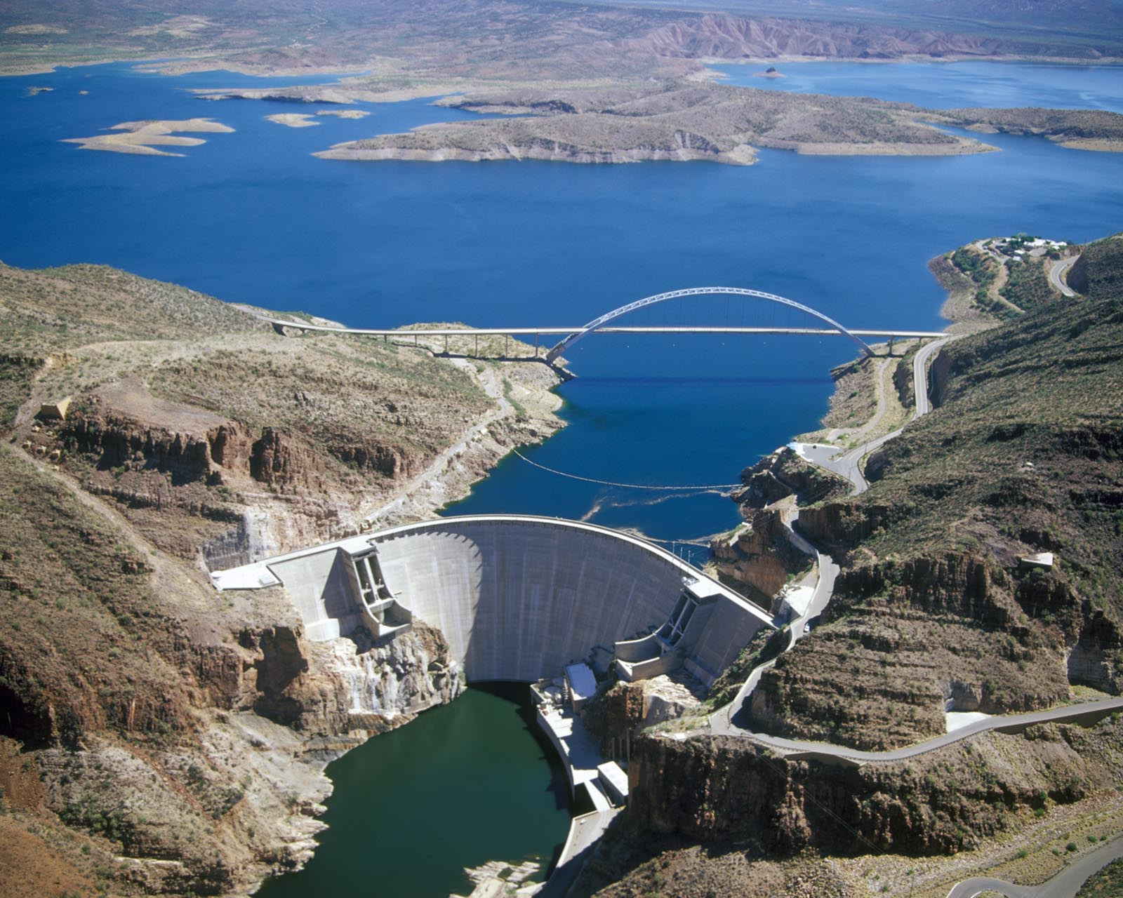

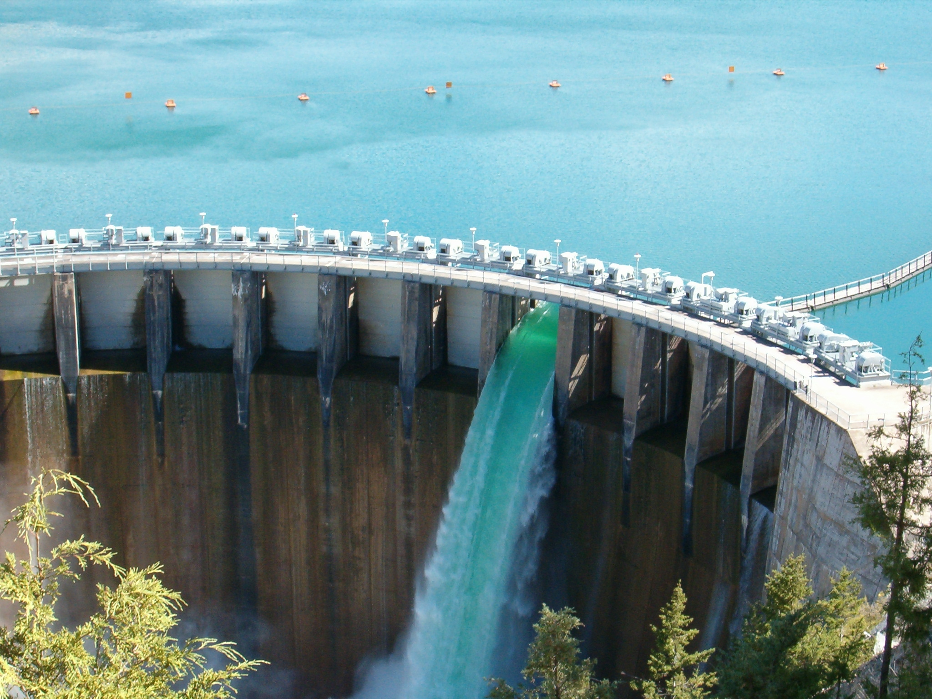
HEC-ResSim Water Quality: Purpose
Need
Reservoir operations simulation software capable of integrating environmental objectives into reservoir release decisions
Purpose
Integrate water quality modeling capabilities into HEC-ResSim, enabling water quality and related objectives to directly inform reservoir release decision-making, while providing capabilities for watershed-scale ecosystem assessment and management
Flows influence water quality
Water quality influences flows

Slide 5
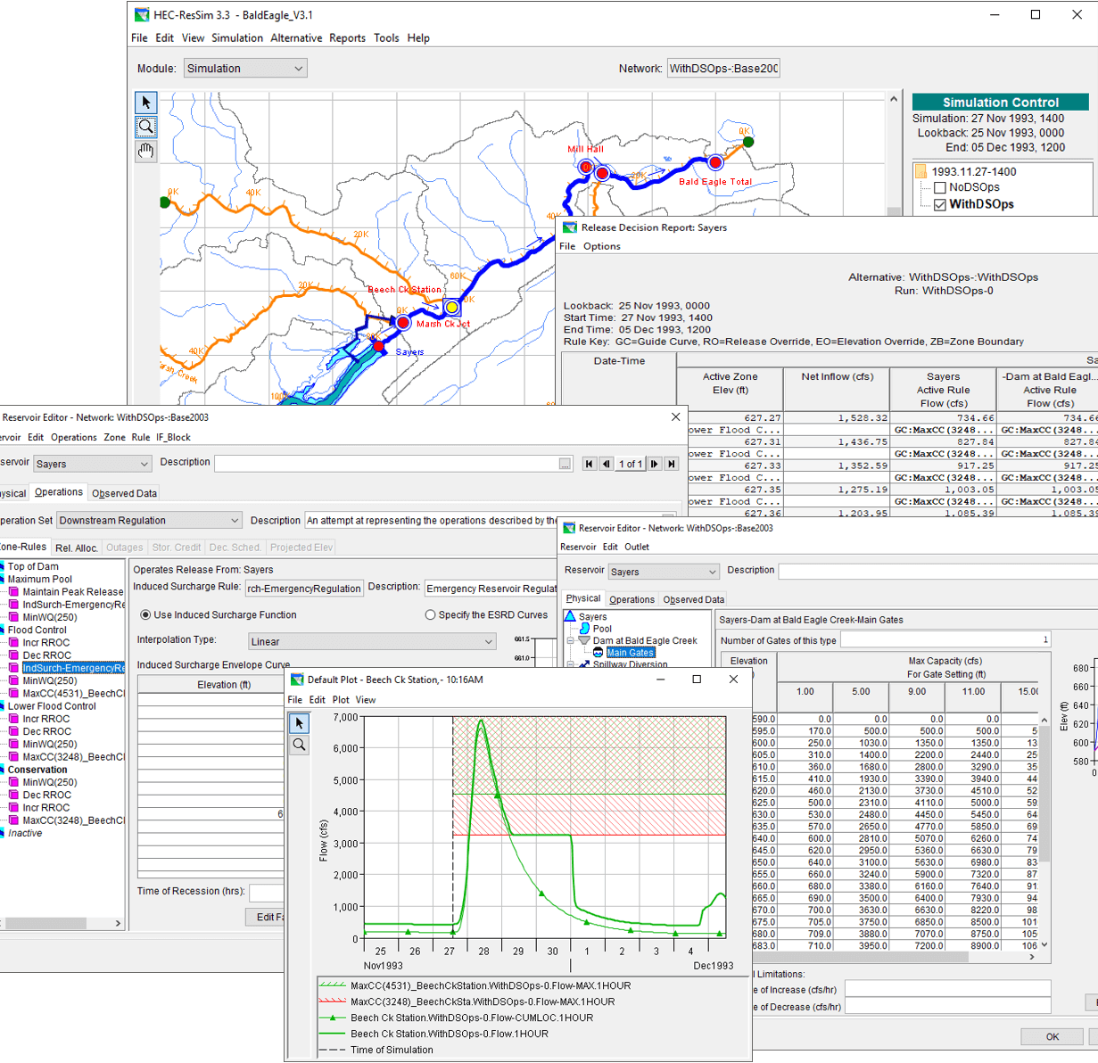
HEC-ResSim Water Quality: Approach
Develop fully integrated water quality capabilities into HEC-ResSim (Reservoir System Simulation)
HEC-ResSim simulates reservoir operations at one or more reservoirs for
Flood management
Low flow augmentation
Water supply
Applications:
Planning studies
Detailed reservoir regulation plan investigations
Real-time decision support

Slide 6
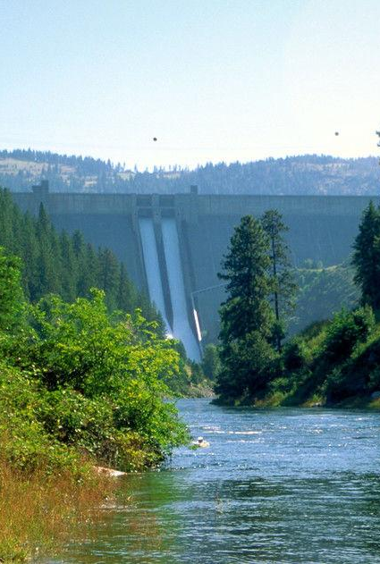
Benefits
HEC-ResSim is a widely deployed reservoir operations modeling program:
Users can compare multiple alternatives for planning studies.
HEC-ResSim forms a critical part of the U.S. Army Corps of Engineers’ Corps Water Management System (CWMS) for real-time operation decision-making.
Impacts Assessment:
WQ capabilities and graphics are integrated, allowing rapid, efficient, and effective environmental impacts assessments.
Environmental Flows:
Users can create reservoir operation rules based on temperatures and constituent concentration..
Rules based on flow or stage can be used in conjunction with WQ rules for ecosystem restoration and management (E-flows).
Selective withdrawal supports reservoirs with selective withdrawal structures.

Slide 7
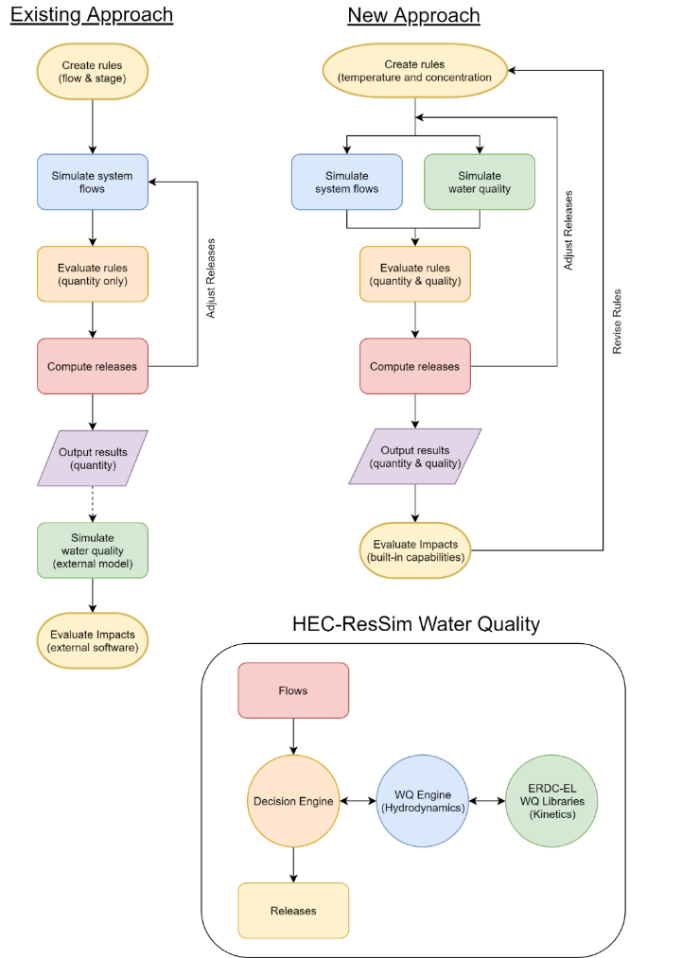
Integrating Water Quality in Reservoir Release Decision-Making
Typical Modeling Strategy:
WQ is simulated after computing the hydrology and release decisions.
WQ operation rules are specified indirectly (using stage and flow) to meet environmental objectives.
Environmental objectives are often combined with other objectives, like navigation, flood control, or hydropower.
If the desired environmental benefits of an alternative are not achieved, new guesses need to be made, and the simulation recomputed. This stage is often skipped altogether.
New Capabilities:
WQ is simulated in parallel with the hydrology and release decisions.
WQ operation rules can be specified directly (temperature, concentration, or load) to meet environmental objectives.
Environmental objectives can be specified and managed independently of other objectives, clarifying the environmental impacts of operation decisions.
(Manually)

Slide 8
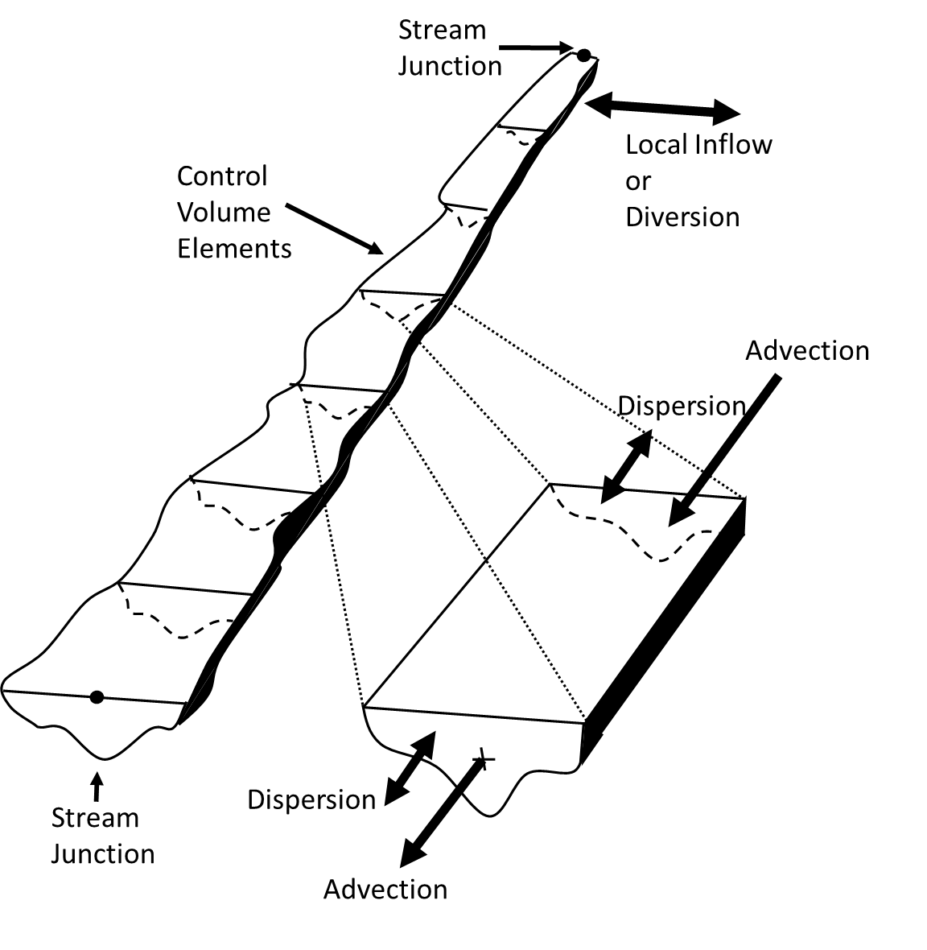
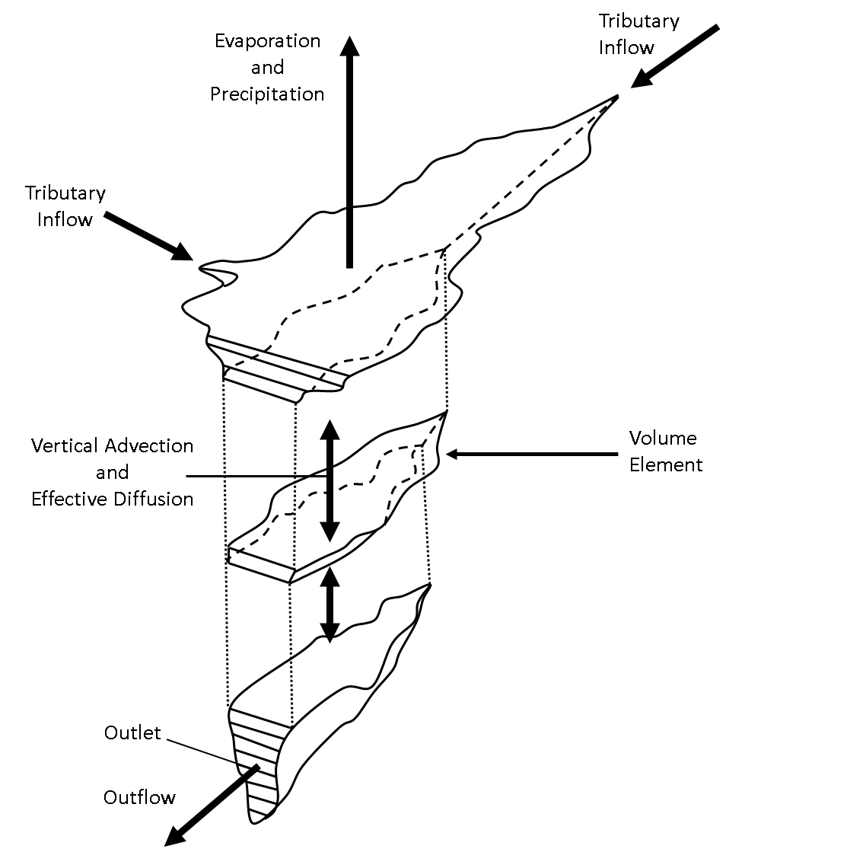

Water Quality Transport Engine
$$\underset{\begin{aligned}\text{time} \\ \text{derivative}\end{aligned}}{\underbrace{\frac{∂C}{∂t}}}+ \underset{\text{advection}}{\underbrace{\frac{∂\left(vC\right)}{∂x}}} = \underset{\text{diffusion}}{\underbrace{\frac{∂}{∂x}\left(K\frac{∂c}{dx}\right)}} + \text{sources}\text{/}\text{sinks}$$
Finite Volume Numerical Scheme
1D river reach with junctions
1D vertically stratified reservoir
Explicit solution scheme with sub-stepping
Cell face concentrations determined with 1st order upwind method; 2nd order flux-limiting method in testing.
Accept flows computed by hydraulic or hydrologic routing
(1D)
1D Reach
1D Reservoir
RMA, “Generalized One-Dimensional Reservoir and River Water Quality Engine Prototype”, prepared for the USACE Hydrologic Engineering Center, November 2017

Slide 9
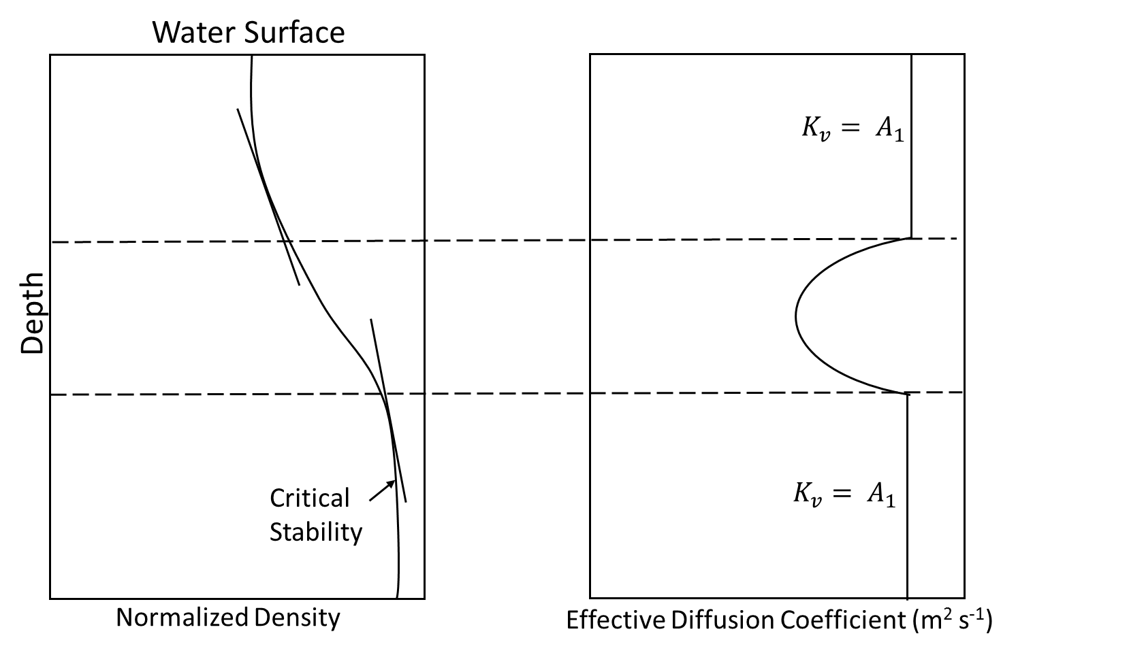

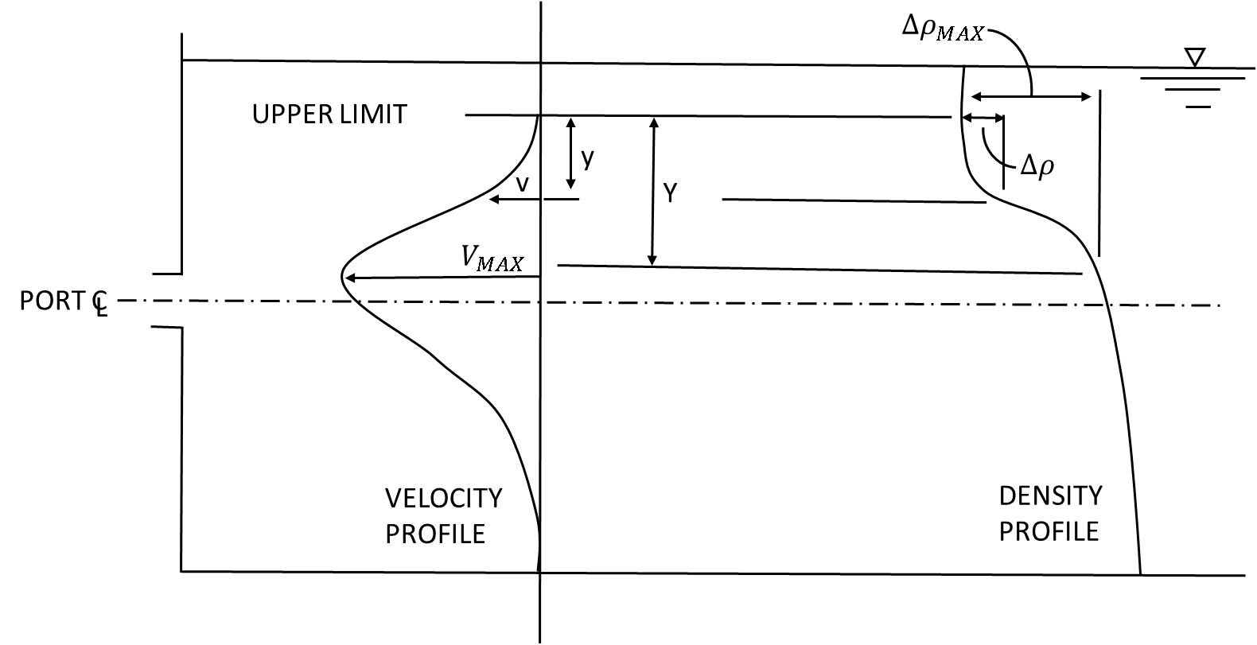
Density-Stratified Reservoir Simulations
Vertical Diffusion and Mixing Layers
Vertical diffusion and layer stability are related to surface wind and density gradients, which are in turn functions of temperature, salinity, or suspended solids
Inflow Allocation
Determine reservoir layer with density equal to inflow density.
If in upper or lower mixed zones (epilimnion or hypolimnion), distribute over zone.
If in stratified zone, determine thickness of inflow zone.
Withdrawal Allocation
Layers from which water is withdrawn is a function of the outlet elevation and size, density distribution, and flow rate.
Methodologies adapted from HEC-RAS-WQ, CE-QUAL-R1, CE-QUAL-W2, and HEC-5Q
u
x
z

Slide 10
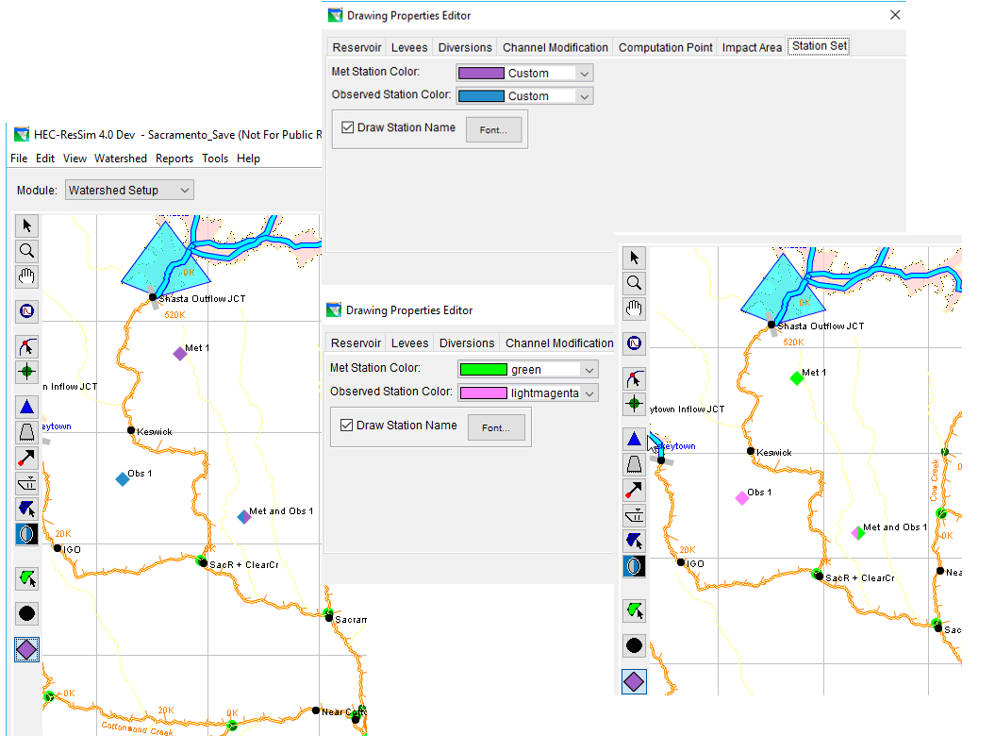
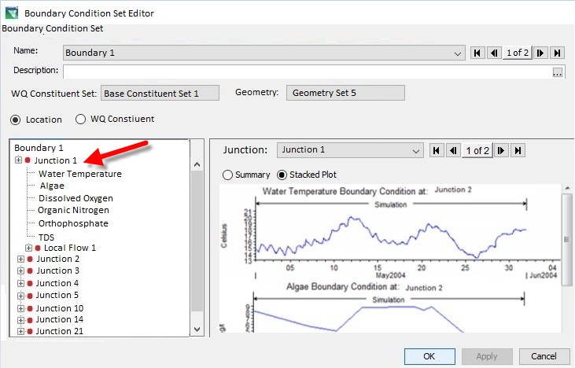
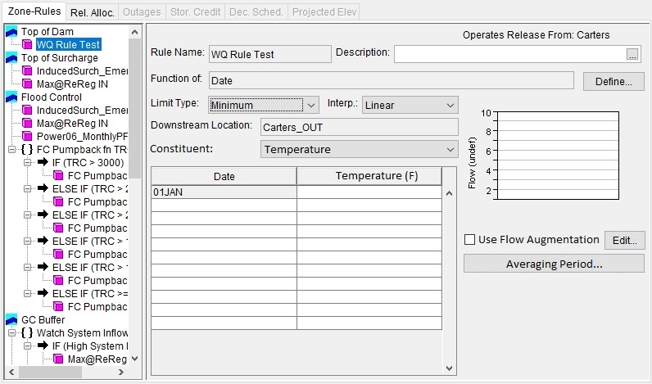
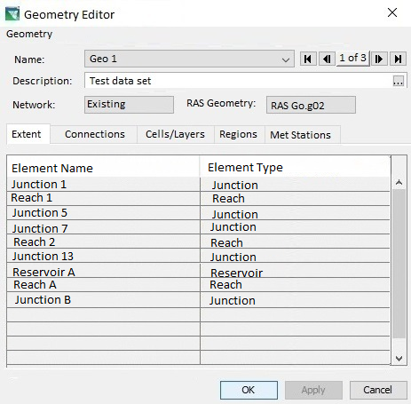
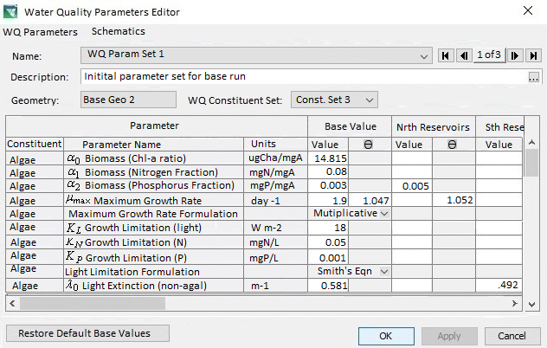
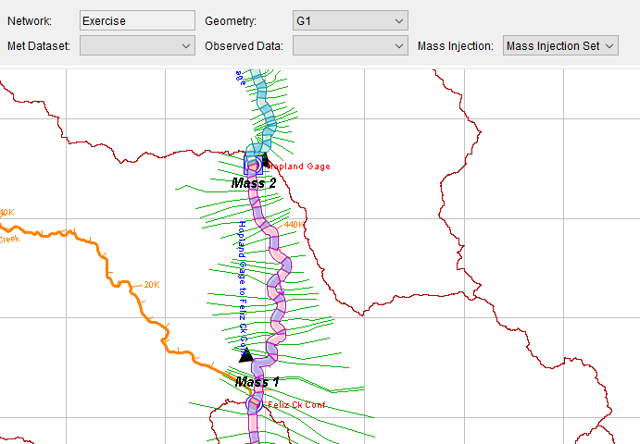
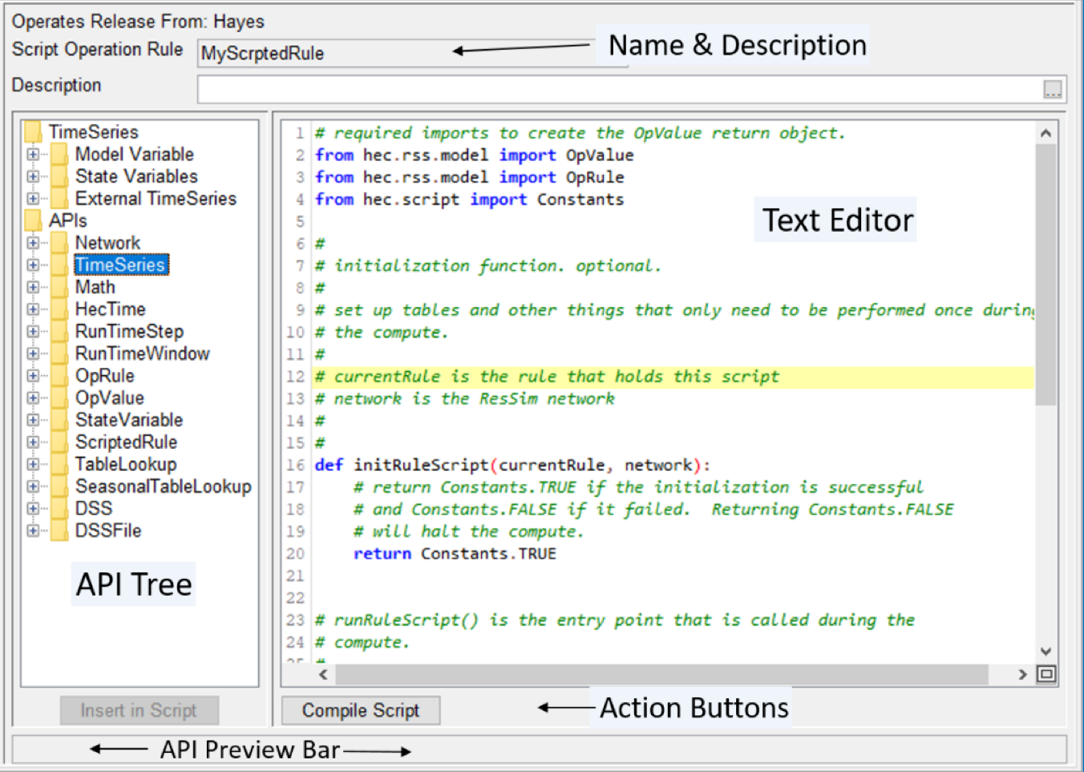
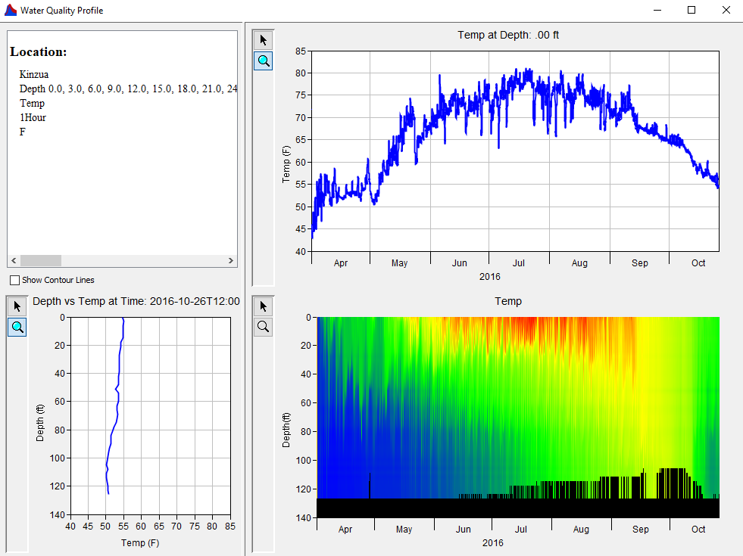
Water Quality Modeling User Interface
Model Geometry
Specifying Boundary Conditions
Operating Rule Priorities
Constituent Relation Parameters
Visualization
Scripted Rules and State Variables

Slide 11
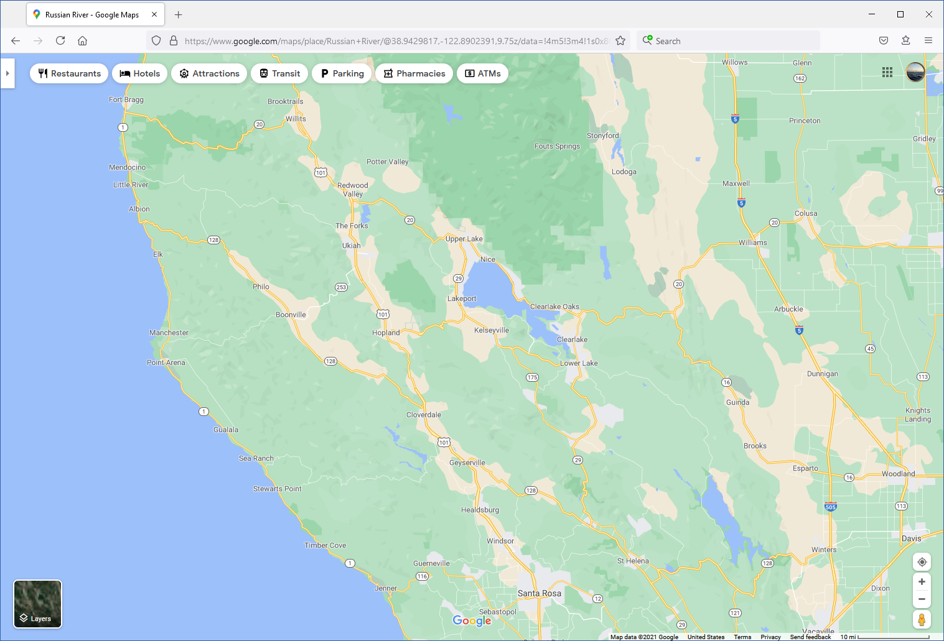
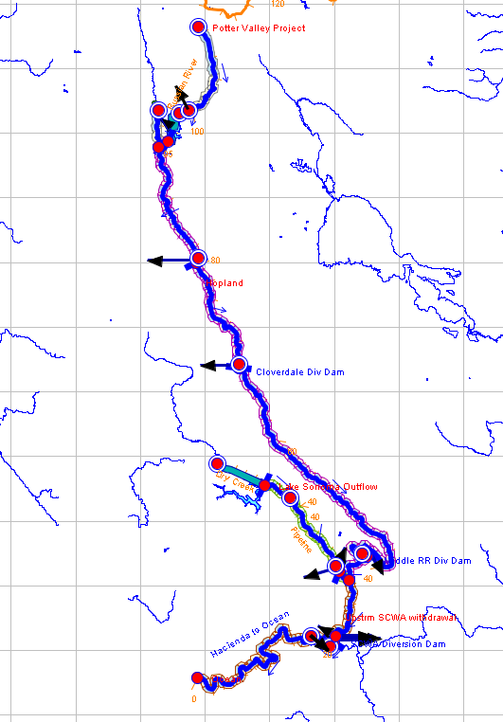
Temperature and Dissolved Oxygen Simulation with HEC-ResSim Russian River, California Performed by RMA for the Sonoma County Water Agency
Objective: Understanding impacts of Lake Mendocino, Lake Sonoma, and temporary diversion dams on temperature and dissolved oxygen throughout the Russian River System
Phytoplankton has an important impact on light penetration in the reservoirs, which impacts stratification.
Benthic algae has an important impact on diurnal variation in dissolved oxygen in the river reaches.
HEC-ResSim WQ will be the replacement for the legacy HEC-5Q model.
Notes:
Understanding impacts of Lake Mendocino, Lake Sonoma, and temporary diversion dams on temperature and dissolved oxygen throughout the Russian River System
Phytoplankton has an important impact on light penetration in the reservoirs which impact stratification
Benthic algae has an important impact on diurnal variation in dissolved oxygen in the river reaches
HEC-ResSim-WQ will replace the legacy HEC-5Q model

Slide 12
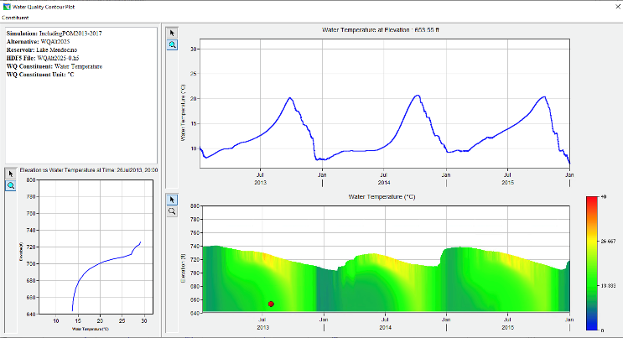
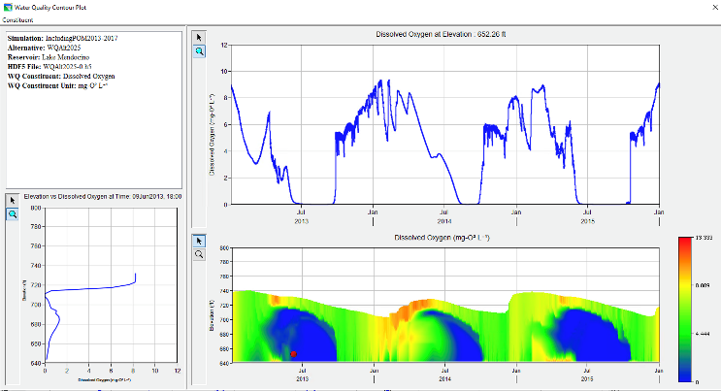
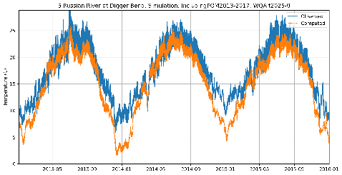
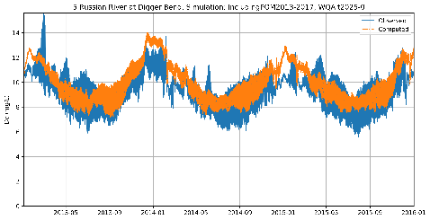
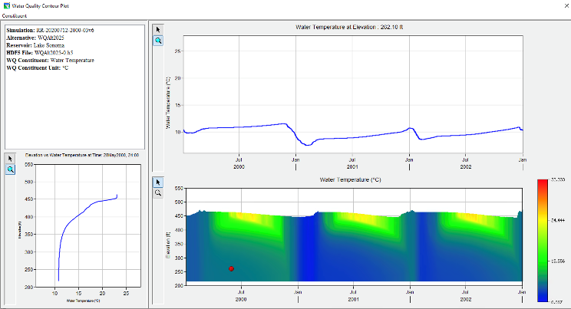
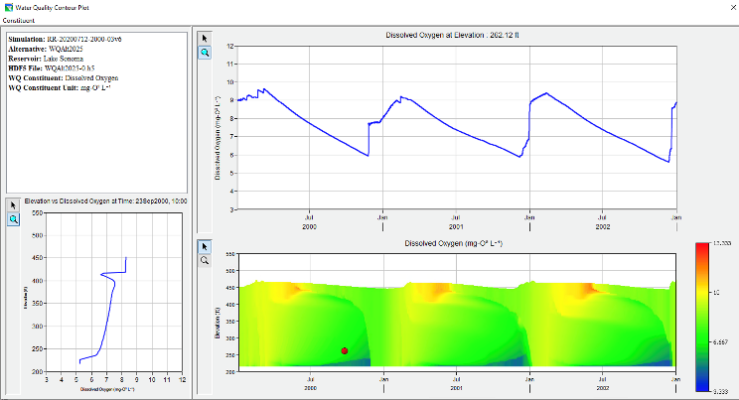
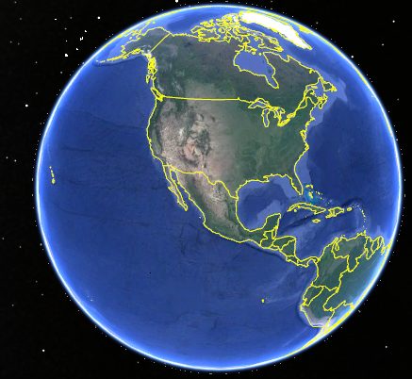
Temperature and Dissolved Oxygen Simulation with HEC-ResSim Russian River, California Performed by RMA for the Sonoma County Water Agency
Temperature
Dissolved Oxygen
Lake Mendocino
Temperature
Dissolved Oxygen
Lake Sonoma
Notes:
Understanding impacts of Lake Mendocino, Lake Sonoma, and temporary diversion dams on temperature and dissolved oxygen throughout the Russian River System
Phytoplankton has an important impact on light penetration in the reservoirs which impact stratification
Benthic algae has an important impact on diurnal variation in dissolved oxygen in the river reaches
HEC-ResSim-WQ will replace the legacy HEC-5Q model

Slide 13
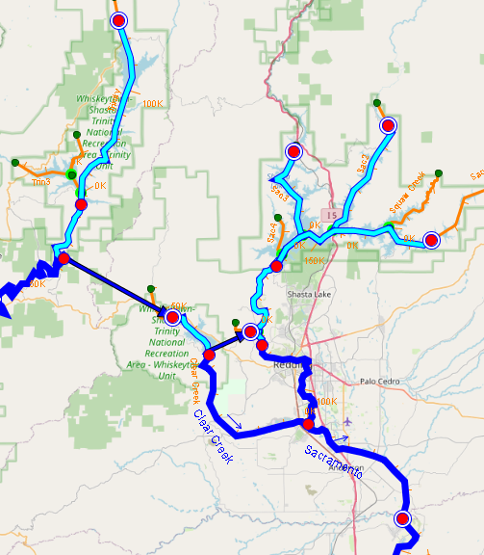
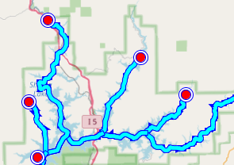
River Temperature & Cold-Water Pool Management Upper Sacramento River Performed by RMA for the U.S. Bureau of Reclamation
Objective: Management of river temperature in region of critical fish habitat
A primary modeling objective is to establish release temperature targets for optimum cold water pool management.
Shasta Temperature Control Device operation (TCD) is a key element of the model.
HEC-ResSim WQ is being tested as eventual replacement for the legacy HEC-5Q model.
The final model will include Shasta, Keswick, Trinity, Lewiston, and Whiskeytown reservoirs along with connecting river segments and tunnels.
Notes:
Management of river temperature in region of critical fish habitat
A primary modeling objective is to establish release temperature targets for optimum cold water pool management
Shasta Temperature Control Device operation (TCD) is a key element of the model
HEC-ResSim-WQ will replace legacy HEC-5Q model
Final model will include Shasta, Keswick, Trinity, Lewiston, and Whiskeytown reservoirs along with connecting river segments and tunnels

Slide 14
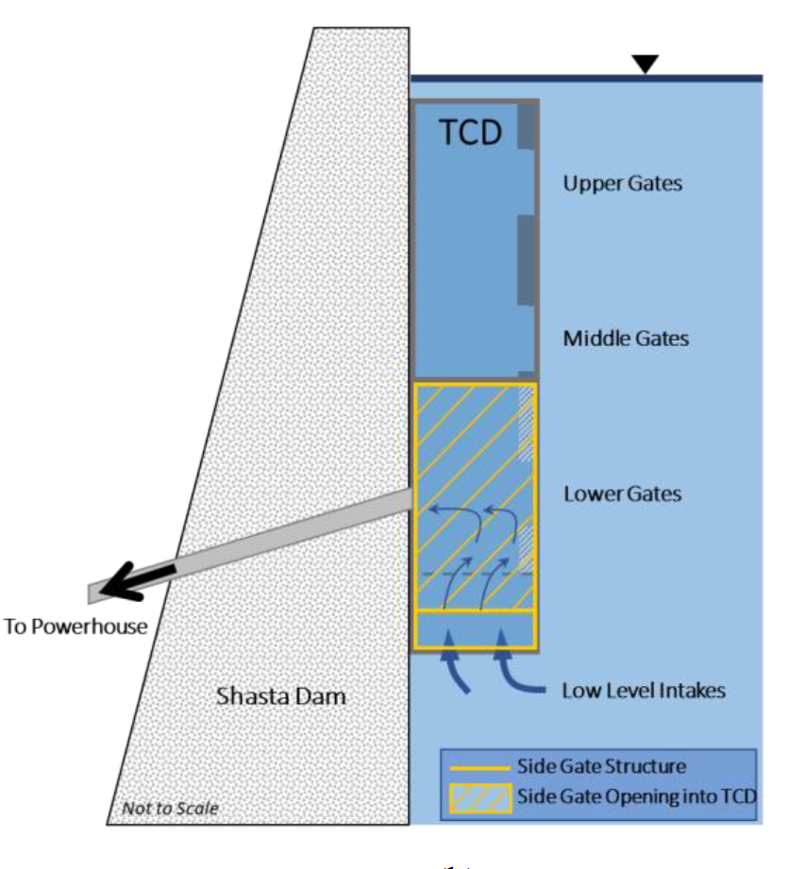
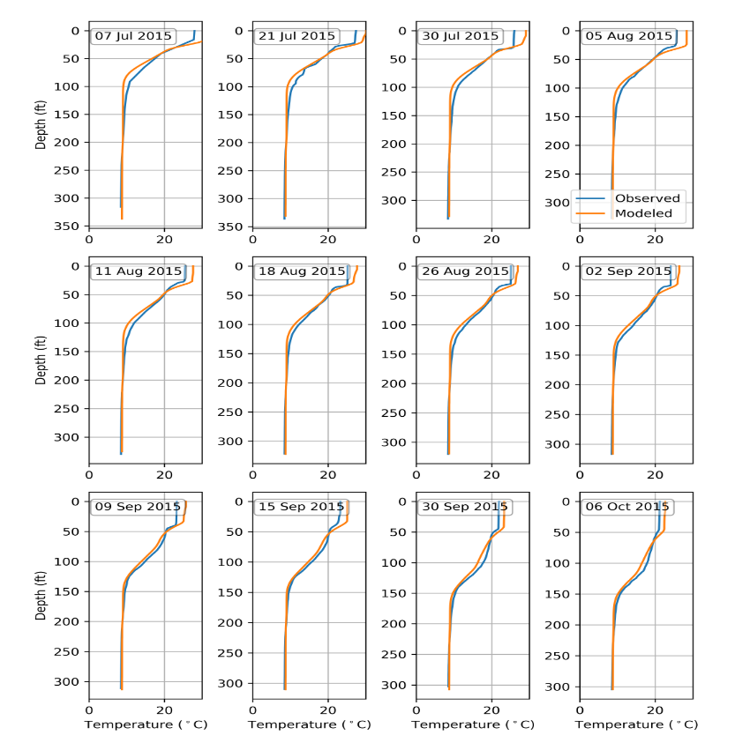
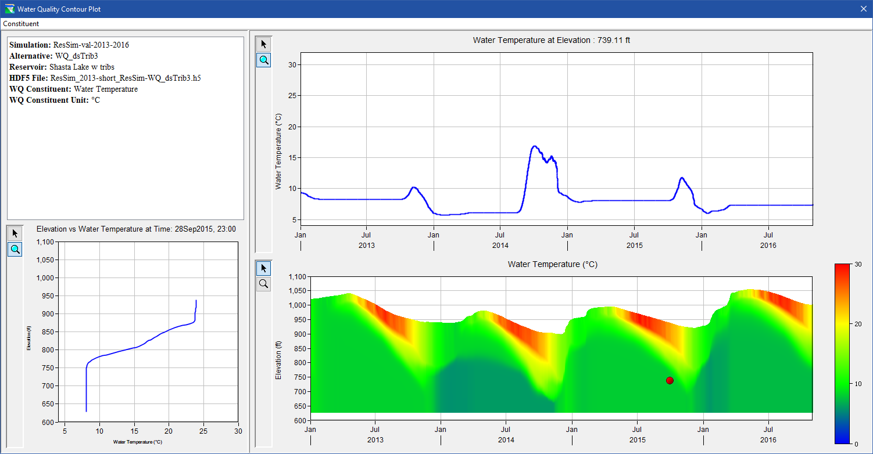
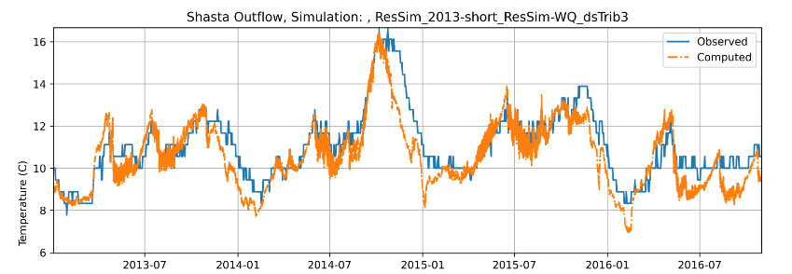
River Temperature & Cold-Water Pool Management Upper Sacramento River Performed by RMA for the U.S. Bureau of Reclamation
Shasta TCD graphic courtesy of Watercourse Engineering
Notes:
Management of river temperature in region of critical fish habitat
A primary modeling objective is to establish release temperature targets for optimum cold water pool management
Shasta Temperature Control Device operation (TCD) is a key element of the model
HEC-ResSim-WQ will replace legacy HEC-5Q model
Final model will include Shasta, Keswick, Trinity, Lewiston, and Whiskeytown reservoirs along with connecting river segments and tunnels

Slide 15
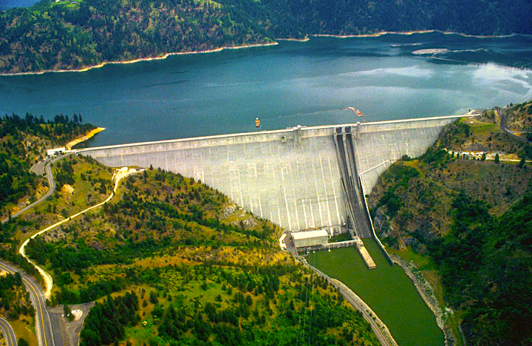
Summary
Water quality capabilities have been implemented in HEC-ResSim.
ClearWater engine and modules: temperature and eutrophication modeling capabilities
The new capabilities integrate water quality simulations with the reservoir system release decision-making process.
Water quality objectives can be specified in terms of temperature and concentration instead of estimated flows and depths.
The user interface enables users to set up and configure water quality models, specify data input and output, create rules for environmental objectives, and visualize results for environmental analyses.
HEC-ResSim is compatible with the HEC integration software packages HEC-WAT and CWMS/RTS.
Two case studies were prepared to demonstrate some of the new WQ capabilities.
Temperature, nutrients, primary production, and dissolved oxygen simulation for the Russian River, CA
Temperature simulation for the upper Sacramento System, CA

Slide 16
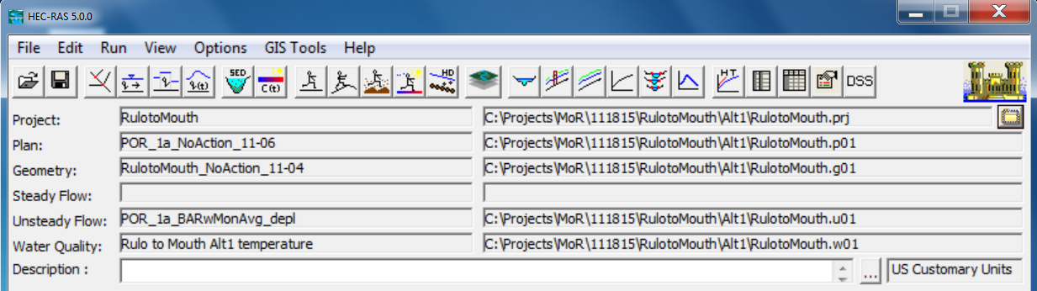
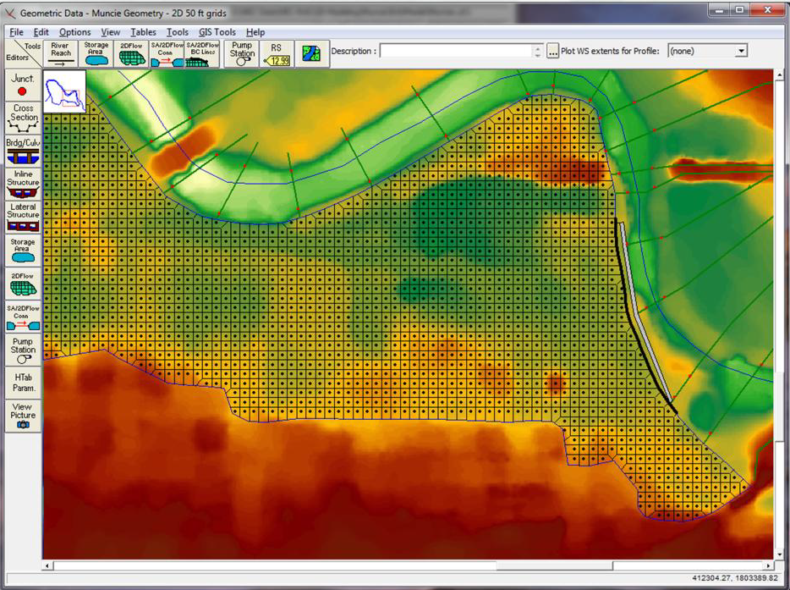
HEC-RAS River Water Quality
Water Quality
Data
Water Quality
Analysis
Notes:
CE-QUAL is from the EPA (numerical methods for constituent transport and fate)
ERDC develop RIV1 that used CE-QUAL transport interaction
RIV1 numberical scheme wasn’t going to work in RAS had to come up with a different one. Finite difference scheme is different that of RIV1
variable grid spacing, variable timestep

Slide 17
Water Temperature Simulation
Heat is a pollutant, water temperature may also directly affect the amount and location of aquatic plant growth
Water temperature is used to correct temperature dependent water quality parameters
Two temperature modules
Full energy budget
Equilibrium temperature

Slide 18
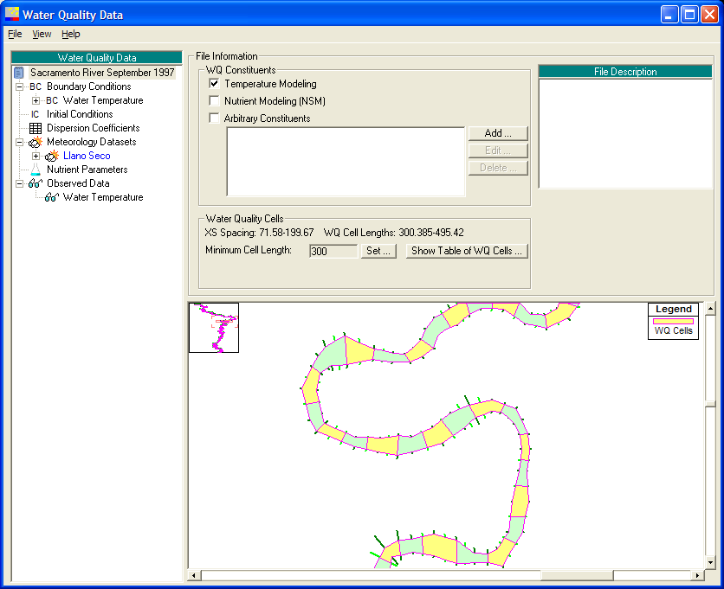
Water Quality Data & Schematic
Finite volume based 1D water quality model
Separation of hydraulics, transport (advection and dispersion), and water quality kinetics
Plug-in water quality modules (libraries)
Water Temperature Simulation Modules (EnergyBudget.dll and Equilibrium.dll)
General Constituent Simulation Module (GCSM.dll)
Nutrient Simulation Module I (NSMI.dll)

Slide 19
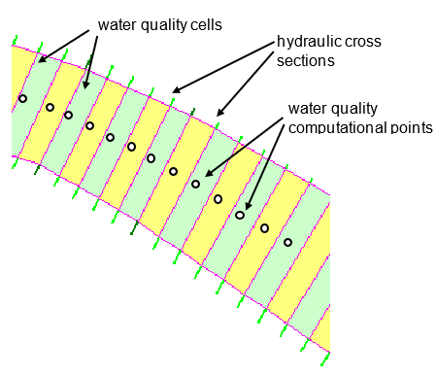
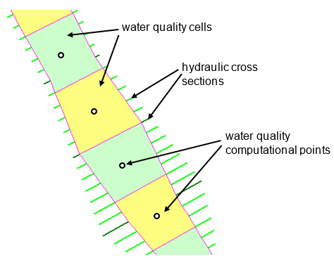
HEC-RAS Water Quality Model Segment Discretization

Slide 20
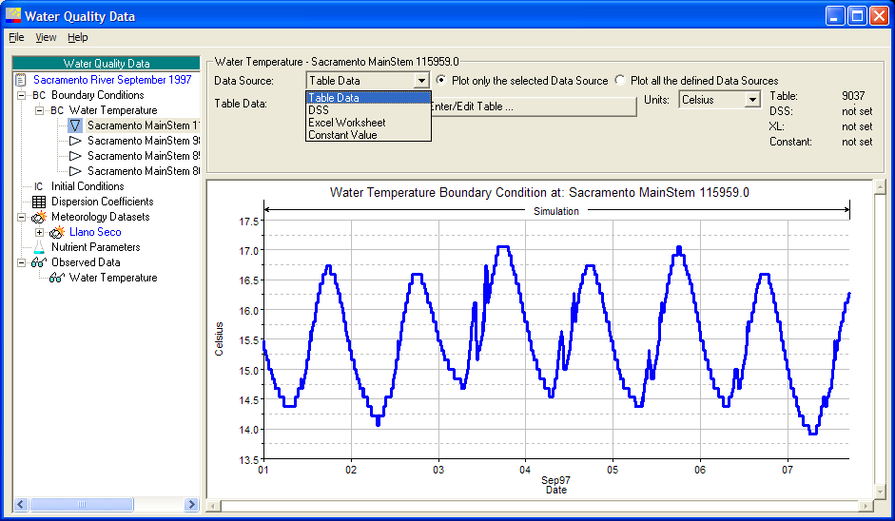
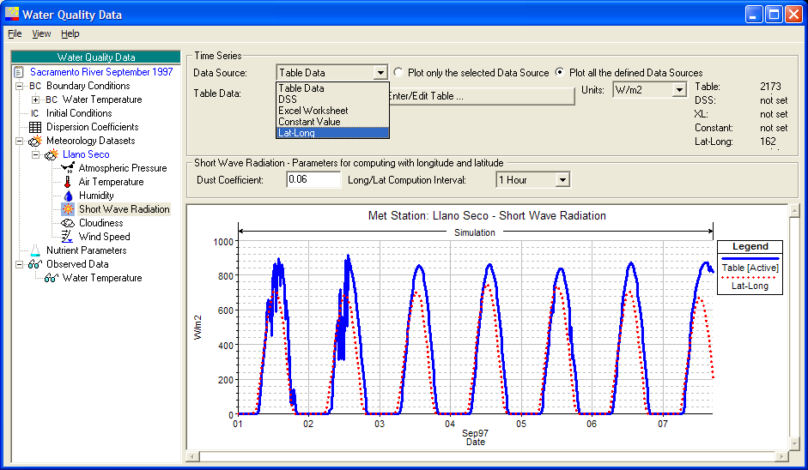

Boundary Conditions
Notes:
summary of multiple data sources at right

Slide 21


Profile Plots
distance approx. 65,000 m velocity approx. 0.75 m/s
1 day travel time
Notes:
a NODE is defined at the reduction of temperature range experienced at a particular location
a NODE is at 80000 and 500
no matter when water leave reservoir experience same temperature at 24hr travel time

Slide 22

Schematic Temperature Plot

Slide 23



HEC-RAS V 6.3 User Interface

Slide 24
Water Column Heat Budget
radiation terms
non-radiation terms
water temperature dependent terms

Slide 25

Bed Sediment Heat Budget
T_{i}
T_{s,i}
0.0035 cm²/s
dT
q
α
(
)
s
,
i
=
s
,
i
q
=
s
T
−
T
dt
ρ
C
h
s
,
i
h
i
si
p
si
s
10 cm

Slide 26
Meteorological Station Data
Meteorological station with parameters
Short wave radiation (W m⁻²)
Atmospheric pressure (mb)
Air temperature (ºC)
Dew point (ºC) or relative humidity (%)
Cloud cover (%)
Wind speed (m s⁻¹)
Hourly meteorological data are typically required for simulating water temperature due to large fluctuations in air temperature and solar radiation.

Slide 27

Application of HEC-RAS Water Quality Model to Missouri River
USGS 06807000
USGS 06934500

Slide 28

Application of HEC-RAS Water Quality Model to the Minnesota River
Twelve (12) tributaries
Eight (8) point sources

Slide 29
ClearWater-Riverine
ERDC-EL is developing a state-of-the-art water quality model, Clearwater-Riverine, that simulates temperature and advanced nutrient cycling in branching river systems and floodplains, incorporating hydrodynamic, water quality, and meteorologic inputs from multiple data sources and models.
ClearWater-Riverine will enable the evaluation of system vulnerabilities and identification of adaptation pathways to improve the resilience of temperate and tropical ecosystems to environmental stresses, which include increasing frequency and intensity of extreme precipitation events and decreasing freshwater flows.
Water quality kinetics, heat budget, and transport simulation capabilities in ClearWater-Riverine are furnished by ERDC's ClearWater modules.
ClearWater-Riverine leverages two-dimensional (2D) HEC-RAS models, which exist for most watersheds, to provide a cost-effective, data-driven tool for impact assessment, planning studies, and the restoration and management of aquatic ecosystems.
2D Water Quality Modeling Framework

Slide 30




ClearWater-Riverine 2D Water Quality Modeling with HEC-RAS
Notes:
Include all PRODUCTS/DELIVERABLES as specified in the original WU documentation

Slide 31
HEC-RAS WQ Benefits
Improves decision-making capabilities and reduces operations and maintenance costs
HEC-RAS models provide detailed river hydraulics data and maps (flow, velocity, and water levels). Integrating water quality capabilities leverages these capabilities and existing models to provide detailed hydraulics and water quality information for riverine systems (rivers, streams, floodplains, etc.).
HEC-RAS is already widely deployed for ecosystem restoration projects – as a hydraulic model. Water quality capabilities provide critical short-term and long-term information about dynamic river systems. This provides important information for designing restoration projects that are stable and functional, while also reducing operations and maintenance costs.
Leverages existing models and expertise, reducing costs. HEC-RAS is widely deployed (100,000 downloads per year), with calibrated hydraulic models already applied to almost all rivers and streams in the U.S., thus significantly reducing the modeling effort and project costs relative to developing separate water quality models.

Slide 32

Team Members and Contributors (Alphabetical)
Lea Adams, USACE-HEC
Marriah Abellera, USACE-IWR
Anthony Aufdenkampe, LimnoTech
Steve Andrews, RMA
Chris Berger, PSU
Tom Brauer, USACE-HEC
Barry Bunch, USACE-ERDC-EL
John DeGeorge, RMA
Tim Dekker, LimnoTech
Mark Dortch, ERDC-EL
Chris Dunn, USACE-HEC
Paul Ely, RMA
Scott English, USACE-NWD
Trudy Estes, ERDC-EL
Matt Fleming, USACE-HEC
Joan Klipsch, USACE-HEC
John Kucharski, USACE-ERDC-EL
Mark Jensen, USACE-HEC
Billy Johnson, USACE-ERDC-EL
Lora Johnson, USACE-ERDC-EL
Shannon Larson, RMA
Cindy Lowney, RMA
Ryan Miles, RMA
Chan Modini, RMA
Isaac Mudge, USACE-MVN
Shannon Newbold, RMA
Jennifer Olszewski, USACE-ERDC-EL
Leila Ostadrahimi, USACE-HEC
Jay Pak, USACE-HEC
Greg Peterson, LimnoTech
Steve Piper, RMA
Daniel Rucinski, LimnoTech
Jason Rutyna, LimnoTech
Jodi Ryder, USACE-ERDC-EL
Alex Sanchez, USACE-HEC
Tad Slawecki, LimnoTech
Don Smith, RMA
Julia Slaughter, USACE-HEC
Todd Steissberg, USACE-ERDC-EL
Kathryn Tackley, USACE-NWP
Tammy Threadgill, USACE-ERDC-EL
Dottie Tillman, USACE-ERDC-EL
Dan Turner, USACE-NWD
Scott Wells, Portland State University
Brian Zettle, USACE-SAM
Zhonglong Zhang, Portland State University

Slide 33
Questions?

Slide 34

HEC-ResSim Water Quality User Interface

Slide 35



WQ Watershed Setup

Slide 36
HEC-ResSim: WQ Module and Mapping Tools

Slide 37




HEC-ResSim: Geometry Editor

Slide 38


HEC-ResSim: WQ Constituent Set Editor

Slide 39
HEC-ResSim: WQ Parameter Set Editor

Slide 40




HEC-ResSim: Meteorological Dataset Editor

Slide 41



HEC-ResSim: Observed Dataset Editors

Slide 42


HEC-ResSim: Boundary Condition Set Editor

Slide 43



HEC-ResSim: Initial Condition Set Editor

Slide 44

HEC-ResSim: Mass Injection Set Editor

Slide 45


HEC-ResSim: Dispersion Coefficient Set Editor

Slide 46


HEC-ResSim: Alternative Editor

Slide 47


HEC-ResSim: Time Series and Output Variables

Slide 48



HEC-ResSim: WQ Rule Operation

Slide 49


HEC-ResSim: Results and Time Series Plots

Slide 50


HEC-ResSim: Contour Plots

